Slide 1

Contemporary
Management
The Changing Face of Business

Slide 2
Let me introduce myself:
I'm Dr. Amanda N Gibson, consultant in Management and Leadership, professor, author and speaker.
My books:
Succession Planning In Nonprofits: The Distance Between
What We Know and What We Do
Nonprofit Realities Everybody Must Face; both available at Amazon.com
Notes:
With a diverse and successful global career encompassing multiple industries and continents, I differentiated myself as an internationalist and global professional; including living and working abroad with multi-national companies. As a senior professional, I’ve proven global success in the deployment of modern leadership, organizational development and management tools and techniques, as well as significant strategic and operational
experience in both for-profit and non-for-profit companies.

Slide 3
Few of today topics:
*
Explain how today’s business workforce and the nature of work itself is changing.
Identify the skills and attributes needed for the 21st century manager.
Define what is business.
Describe the private enterprise system.
Identify the six eras in the history of business.
*
*
*
*

Slide 4

What is Business?
Profit-seeking activities and enterprises provide goods and services necessary to an economic system.
Profit-seeking is the reward for business people who take the risk involved to offer goods and services to customers.
See Fortune 500 for a list of major U.S. companies.
Notes:
Some businesses produce tangible goods while others provide services. Businesses are large enterprises like General Electric or Microsoft or the small cleaners in your neighborhood. Profits are the central focus of business because without profits, a company could not survive.

Slide 5
The Private Enterprise System
Capitalism
Adam Smith is the father of capitalism.
“Invisible Hand”
Economic system determines business ownership, profits, and resources
Rewards firms for their ability to serve the needs of consumers
Minimized government intervention
Competition is the battle among businesses for consumer acceptance.
Notes:
Adam Smith first described capitalism in his famous book, Wealth of Nations, and coined the phrase “Invisible Hand.” The private enterprise system minimizes government interference in economic activity. Firms are rewarded for their ability to compete and meet consumer needs. Competition regulates economic life and is a key premise of capitalism in the US. To compete, each firm must find a competitive differentiation – the unique combination of organizational abilities, products, and approaches.
Lecture Enhancer: Name two of Walmart’s competitors.
Lecture Enhancer: How does Walmart differentiate itself among its competitors?

Slide 6
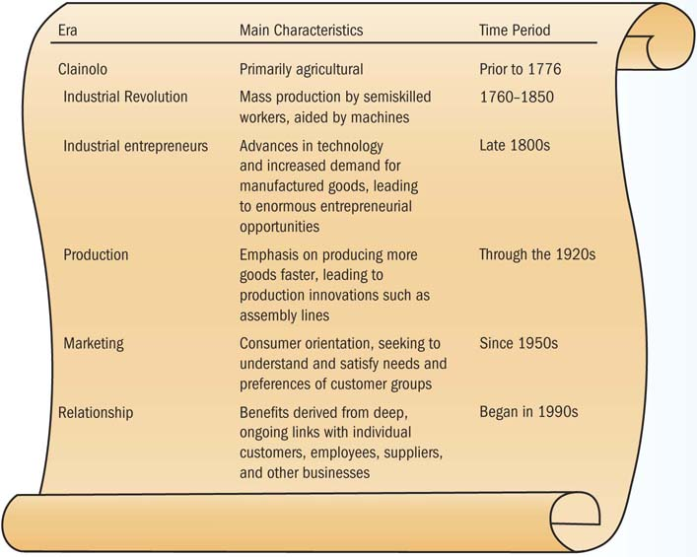
Six Eras in the History of U.S. Business
Notes:
In 400 years, the U.S. business history has gone through six distinct time periods: the colonial period, the Industrial Revolution, the age of industrial entrepreneurs, the production era, the marketing era, and the relationship era. All of these periods are unique because they have influenced U.S business practices in different ways.
Class Activity: Ask students to provide examples of people today who currently earn their income by the making of crafts.
Class Activity: Lead a discussion to identify the oldest companies in the local area or state that continue their operations.
Lecture Enhancer: Compare the options available to buyers of a Ford automobile today compared to during the production era.
Lecture Enhancer: Compare and contrast the brand identities of Walmart and Target.
Lecture Enhancer: Give 3 examples of different brands of athletic shoes. How does each brand differentiate itself within the market?

Slide 7
Today’s Business Workforce
Dedicated workers who can foster strong ties with customers
Capable of high-quality production
Able to compete in global markets
Technically savvy
Notes:
A skilled and knowledgeable workforce is an essential resource for keeping pace with the changing business world. A first-class workforce can be the foundation of a firm’s competitive differentiation, providing important advantages over competing business.

Slide 8
Changes in the Workforce:
Aging Population
By 2030, the number of U.S. workers 65 or older will reach 72 million.
Many baby boomers are hitting the peak of their careers, while Generations X and Y are launching their careers.
Technology has intensified the hiring challenge by requiring workers to have ever more advanced skills.
U.S. Census Bureau
Notes:
There is a widening age spectrum of the workforce. This broad age diversity brings management challenges with it, such as accommodating a variety of work-life styles, changing expectations of work, and varying levels of technological expertise. Use the census.gov website to review the population information (age, education, income, etc.) for some zip codes in your geographic area.
Class Activity: Ask students what businesses might benefit or suffer from the aging “baby boomer" population.
Lecture Enhancer: What unique skills might each generation bring to the workplace?

Slide 9
Changes in the Workforce:
Shrinking Labor Pool/Diversity
Economists predict the U.S. labor pool could soon fall short by as many as 10 million people.
The two fastest-growing ethnic populations in the United States are Hispanics and people of Asian origin.
Employee teams with individuals of different genders, ethnic backgrounds, cultures, religions, ages, and physical and mental abilities are more effective.
Notes:
Diverse employee teams and workforces tend to perform tasks more effectively and develop better solutions to business problems because of their varied perspectives and experiences. Attention to diversity issues can help them avoid damaging legal battles.
Class Activity: Obtain the class' experiences in working in teams with diverse membership. What were the benefits and difficulties the teams encountered?
Lecture Enhancer: Why might diverse workforces offer more innovative solutions to business problems than homogeneous workforces?

Slide 10
Changes in the Workforce:
Flexibility and Innovation through Collaboration
Younger workers are looking to something other than work-comes-first
Telecommuting and job-sharing
Part-time and temporary workers are growing
Collaboration is replacing working alone
Value risk-taking and innovation
Notes:
Workers want a flexible work-life balance that rewards them for their skills. These workers use technology and manage their own careers. The relationship between employees and workers needs to be a valuable partnership that drives innovation through collaboration.
Class Activity: Survey the class to see if how many students work on a flexible or part- time basis.

Slide 11
The 21st-Century Manager
Critical-thinking
Creative
Able to lead change
Visionary
Notes:
Today’s companies look for managers who are intelligent, highly motivated people with the ability to create and sustain a vision for the organization. Critical thinking is the ability to analyze and assess information to pinpoint problems or opportunities. The challenges in today’s marketplace require managers to perceive the marketplace needs and what an organization must do to satisfy them. There are many challenges facing today’s managers.

Slide 12
Critical Thinking and Creativity
Critical thinking is the ability to analyze and assess information to pinpoint problems or opportunities.
Creativity is the capacity to develop novel solutions to perceived organizational problems.
Notes:
Creativity and critical thinking are imperative in today’s workplace, but they must lead to action. These are essential characteristics of the 21st-century workforce. These skills are important throughout the organization.
Class Activity: Lead a class “brainstorming” discussion asking students for a name for a new oil and lubrication business that also will sell coffee and snacks while customers wait in a comfortable lounge area.

Slide 13
Ability to Lead Change
Guide employees and organizations through changes
Managers must be comfortable with tough decisions.
Factors that require organizational change can come from external and internal sources.
Notes:
Changes brought on by technology, the marketplace, and global competition require leadership. Organizational change may come internally from new company goals, emerging employee needs, labor union demands, or production problems. External forces might include feedback from customers, developments in the international marketplace, economic trends, and new technologies.

Slide 14



Thank you!
ANG Management Coaching and Consulting offers a variety of consulting services for small business owners, designed to address everything from major strategic issues to more basic problems affecting everyday business practices.
Additional Resources:
Seminars
Books
Call us!
ANG – MCC identifies, researches alternatives and solves business problems with the highest value-adding solutions.
Our team of professionals looks forward to meeting you at one of our seminars, at our conference booths, through various communications channels, or just to connect through social media (see details at www.ang-mcc.com).

